Slide 1
Hybrid Search Midpoint Presentation
Group A
Chaman Ali | 15016005
Surendra Dura | 15007669
Keith Feeney | 15015556
Chenlei Jie | 01318877
Business Application Development | June 2018

Slide 2
Content
Project idea
SCRUM
Technologies used
Demo

Slide 3
Scrum
What we have done (User Stories)
Sprints 1-3
Daily Meeting
Future Sprint and work

Slide 4
What we have done (User Stories)
Customer-Search – Ali (Sprint 1-3)
Company-Add – Chenlei (Sprint 1-3)
User-Reg/Login – Keith (Sprint 1-3)
Customer-Add – Surendra (Sprint 1-2)
Customer-Save – Surendra (Sprint 3)

Slide 5
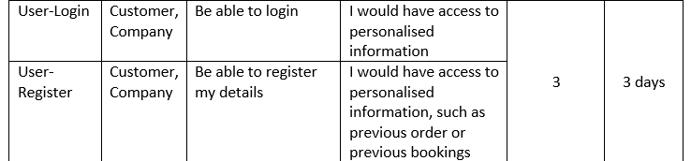
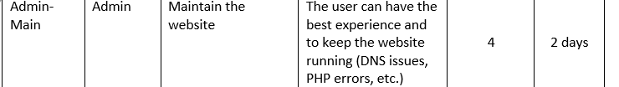
What we have done (User Stories)
Why we choose those tasks?
By Priority

Slide 6
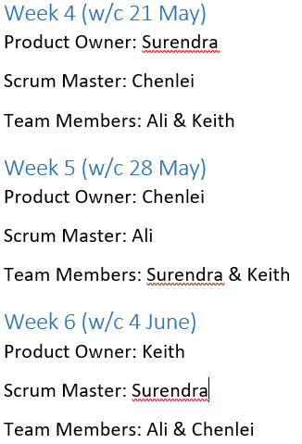
Sprints 1-3

Slide 7

Daily Meeting
What did you do?
What are you going to do for today?
Issues?

Slide 8
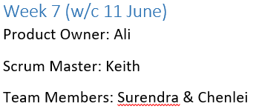
Future Sprint and work
Sprint 4
Customer-Save – Surendra
Customer-Search – Ali
Company-Edit –Chenlei
User-Edit-Account - Keith

